Slide 1

Twitter Storm
Bharath Rajakumar
Harshita Vissa
Sripadmanaban Subramanian

Slide 2
Overview
Using Twitter Storm we are going to find the following information
To count the occurrence of hashtags
To count tweets on an hourly basis
To perform join between username and the tweets to find out the tweets that contain the user mentions (self-join)
To count most number of tweets tweeted in an hour for the entire date range
To count tweets based on location

Slide 3
Technology Used
Storm – Single node cluster with one master node and one worker node.
Zookeeper - It is the coordinator for a Storm cluster. The interaction between the nimbus and the worker nodes is done through the Zookeeper.
ZeroMQ - It is “a library which extends the standard socket interfaces with features traditionally provided by specialized messaging middleware products”. Storm relies on it primarily for task to task communication in running Storm topologies.
MySQL – Database used for storing the output of the topology.
Tableau – Data Analysis tool for displaying charts and graphs

Slide 4
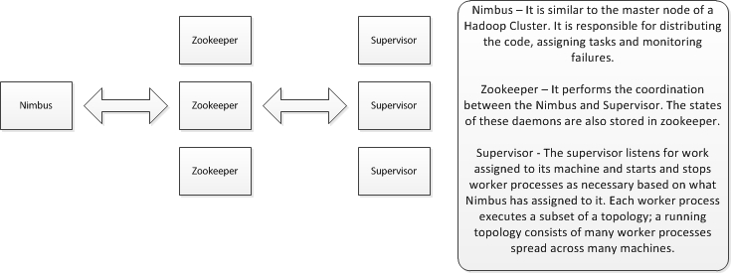
Components of a storm cluster

Slide 5
Dataset
The data is present in a flat file which contains 1,600,000 tweets.
The various fields that exist in our database are :
Timestamp
Username
Tweet
Location(city)
the data set is approximately 250MB in size.

Slide 6
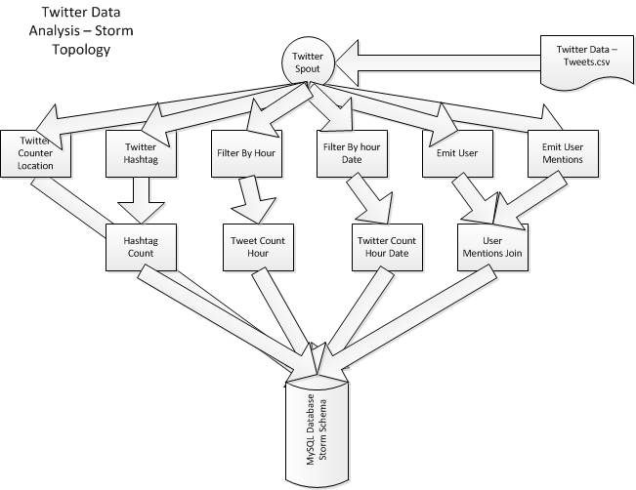
Topology Diagram

Slide 7


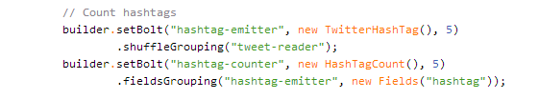
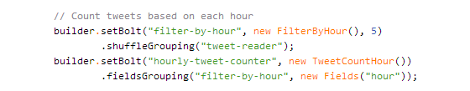
Topology Definition

Slide 8
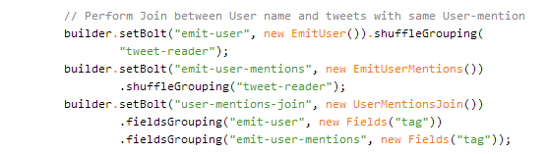
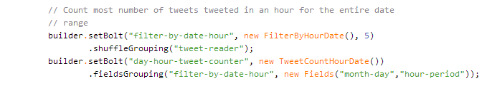

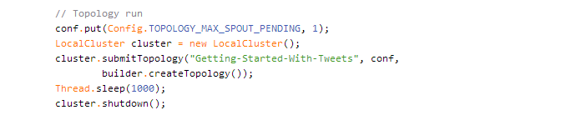

Slide 9
Submitting a Topology
Define the topology
Create a jar file
Submit the topology using the storm client, specifying path of jar, class name to run and any arguments(optional)

Slide 10
Hadoop vs Storm
Batch Processing
Job runs to completion
Job Tracker is a SPOF
Stateful nodes
Scalable
Guarantees no data loss
Real time processing
Topologies run forever
No Single point of failure
Stateless nodes
Scalable
Guarantees no data loss

Slide 11
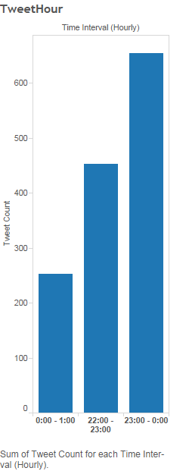
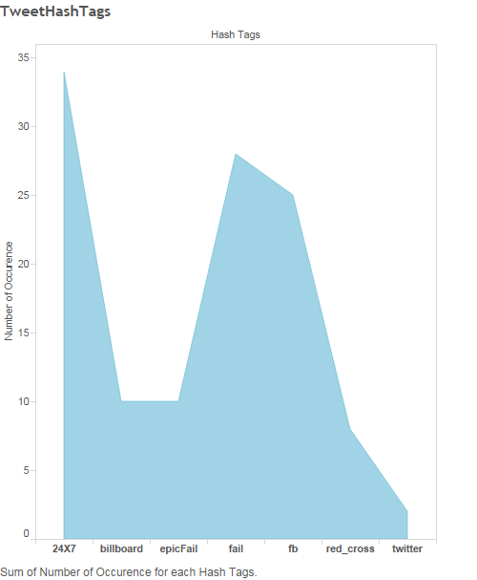
Graphs

Slide 12
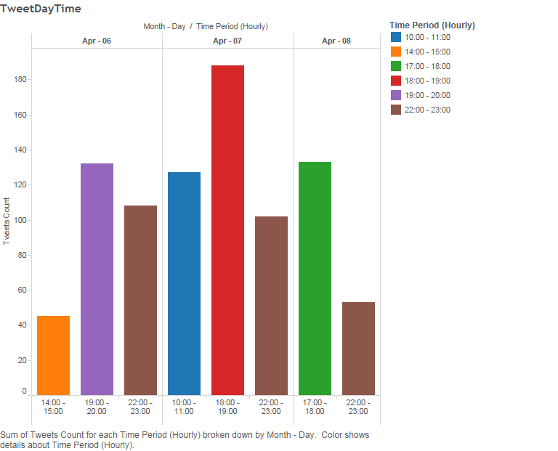
Graphs

Slide 13
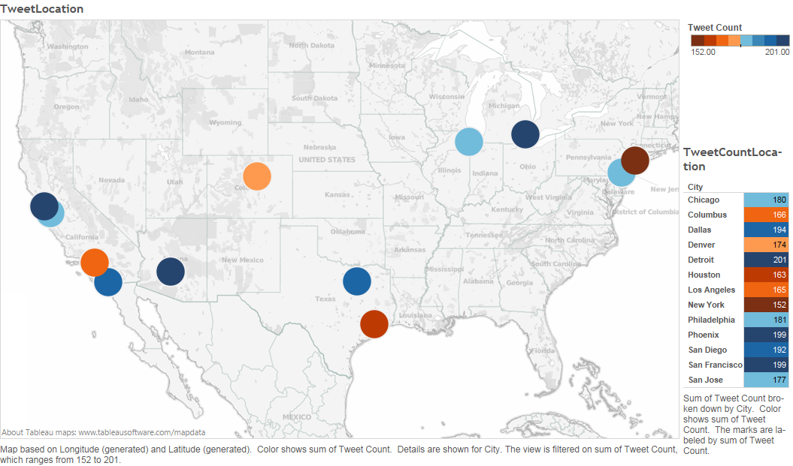
Maps

Slide 14
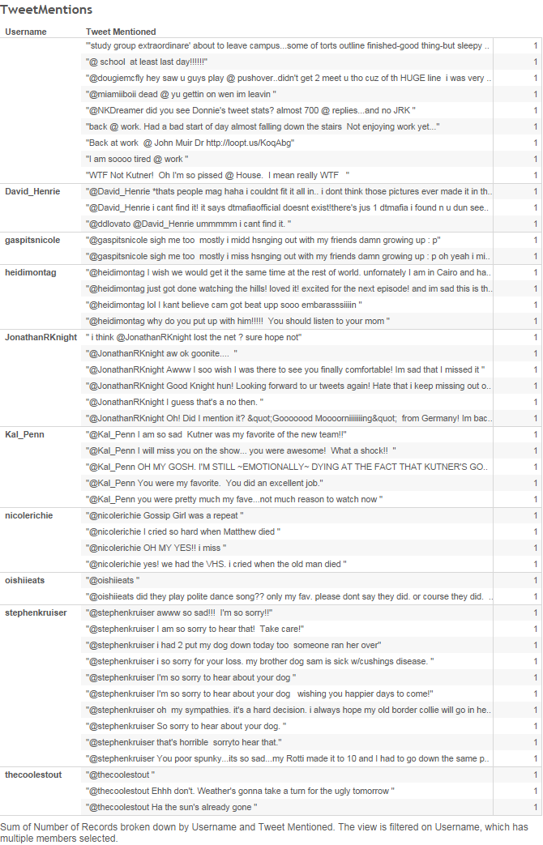

Slide 15
Real world applications of Strom
Organization | Usage
The Weather Channel | For fetching dataset from an internal or external network (the Internet), reshaping the records for use by the company, and persisting the records to relational databases.
Flipboard | Content search, real-time analytics, and generating custom magazine feeds.
Cerner | To process massive amounts of clinical data in real-time to make medical decisions
RocketFuel | To tracks impressions, clicks, conversions, bid requests etc. in real time

Slide 16
Thank you

